Slide 1
Back to School Night
Mrs. Bocanegra
7th Grade

Slide 2
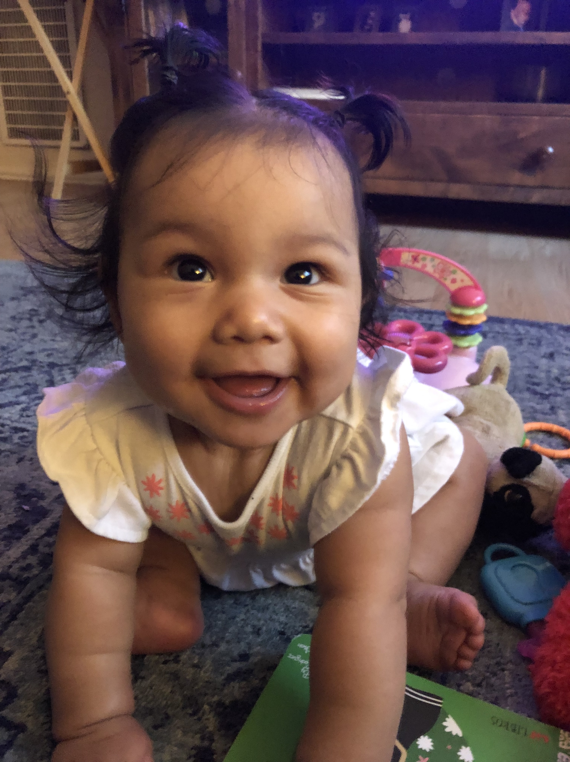
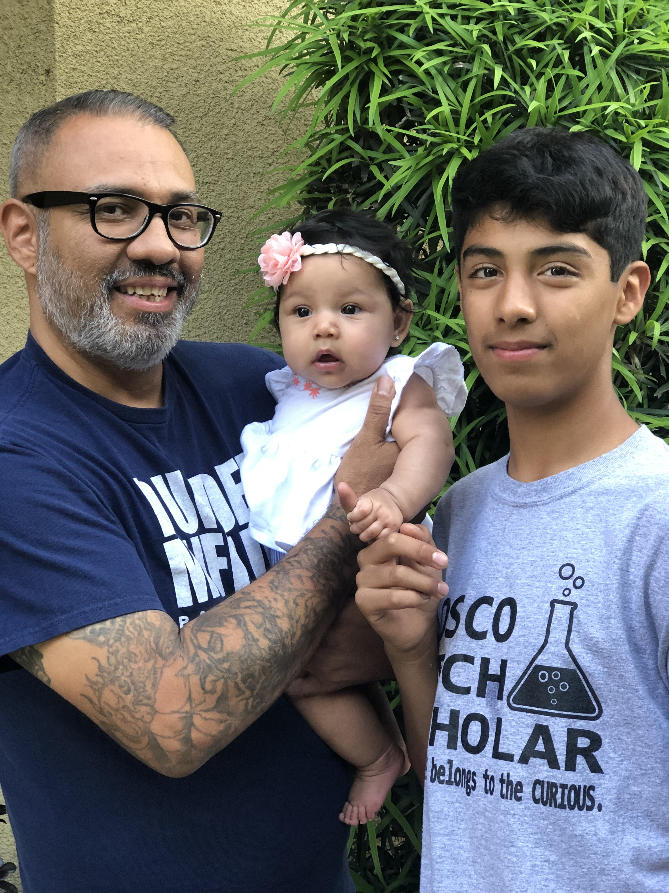
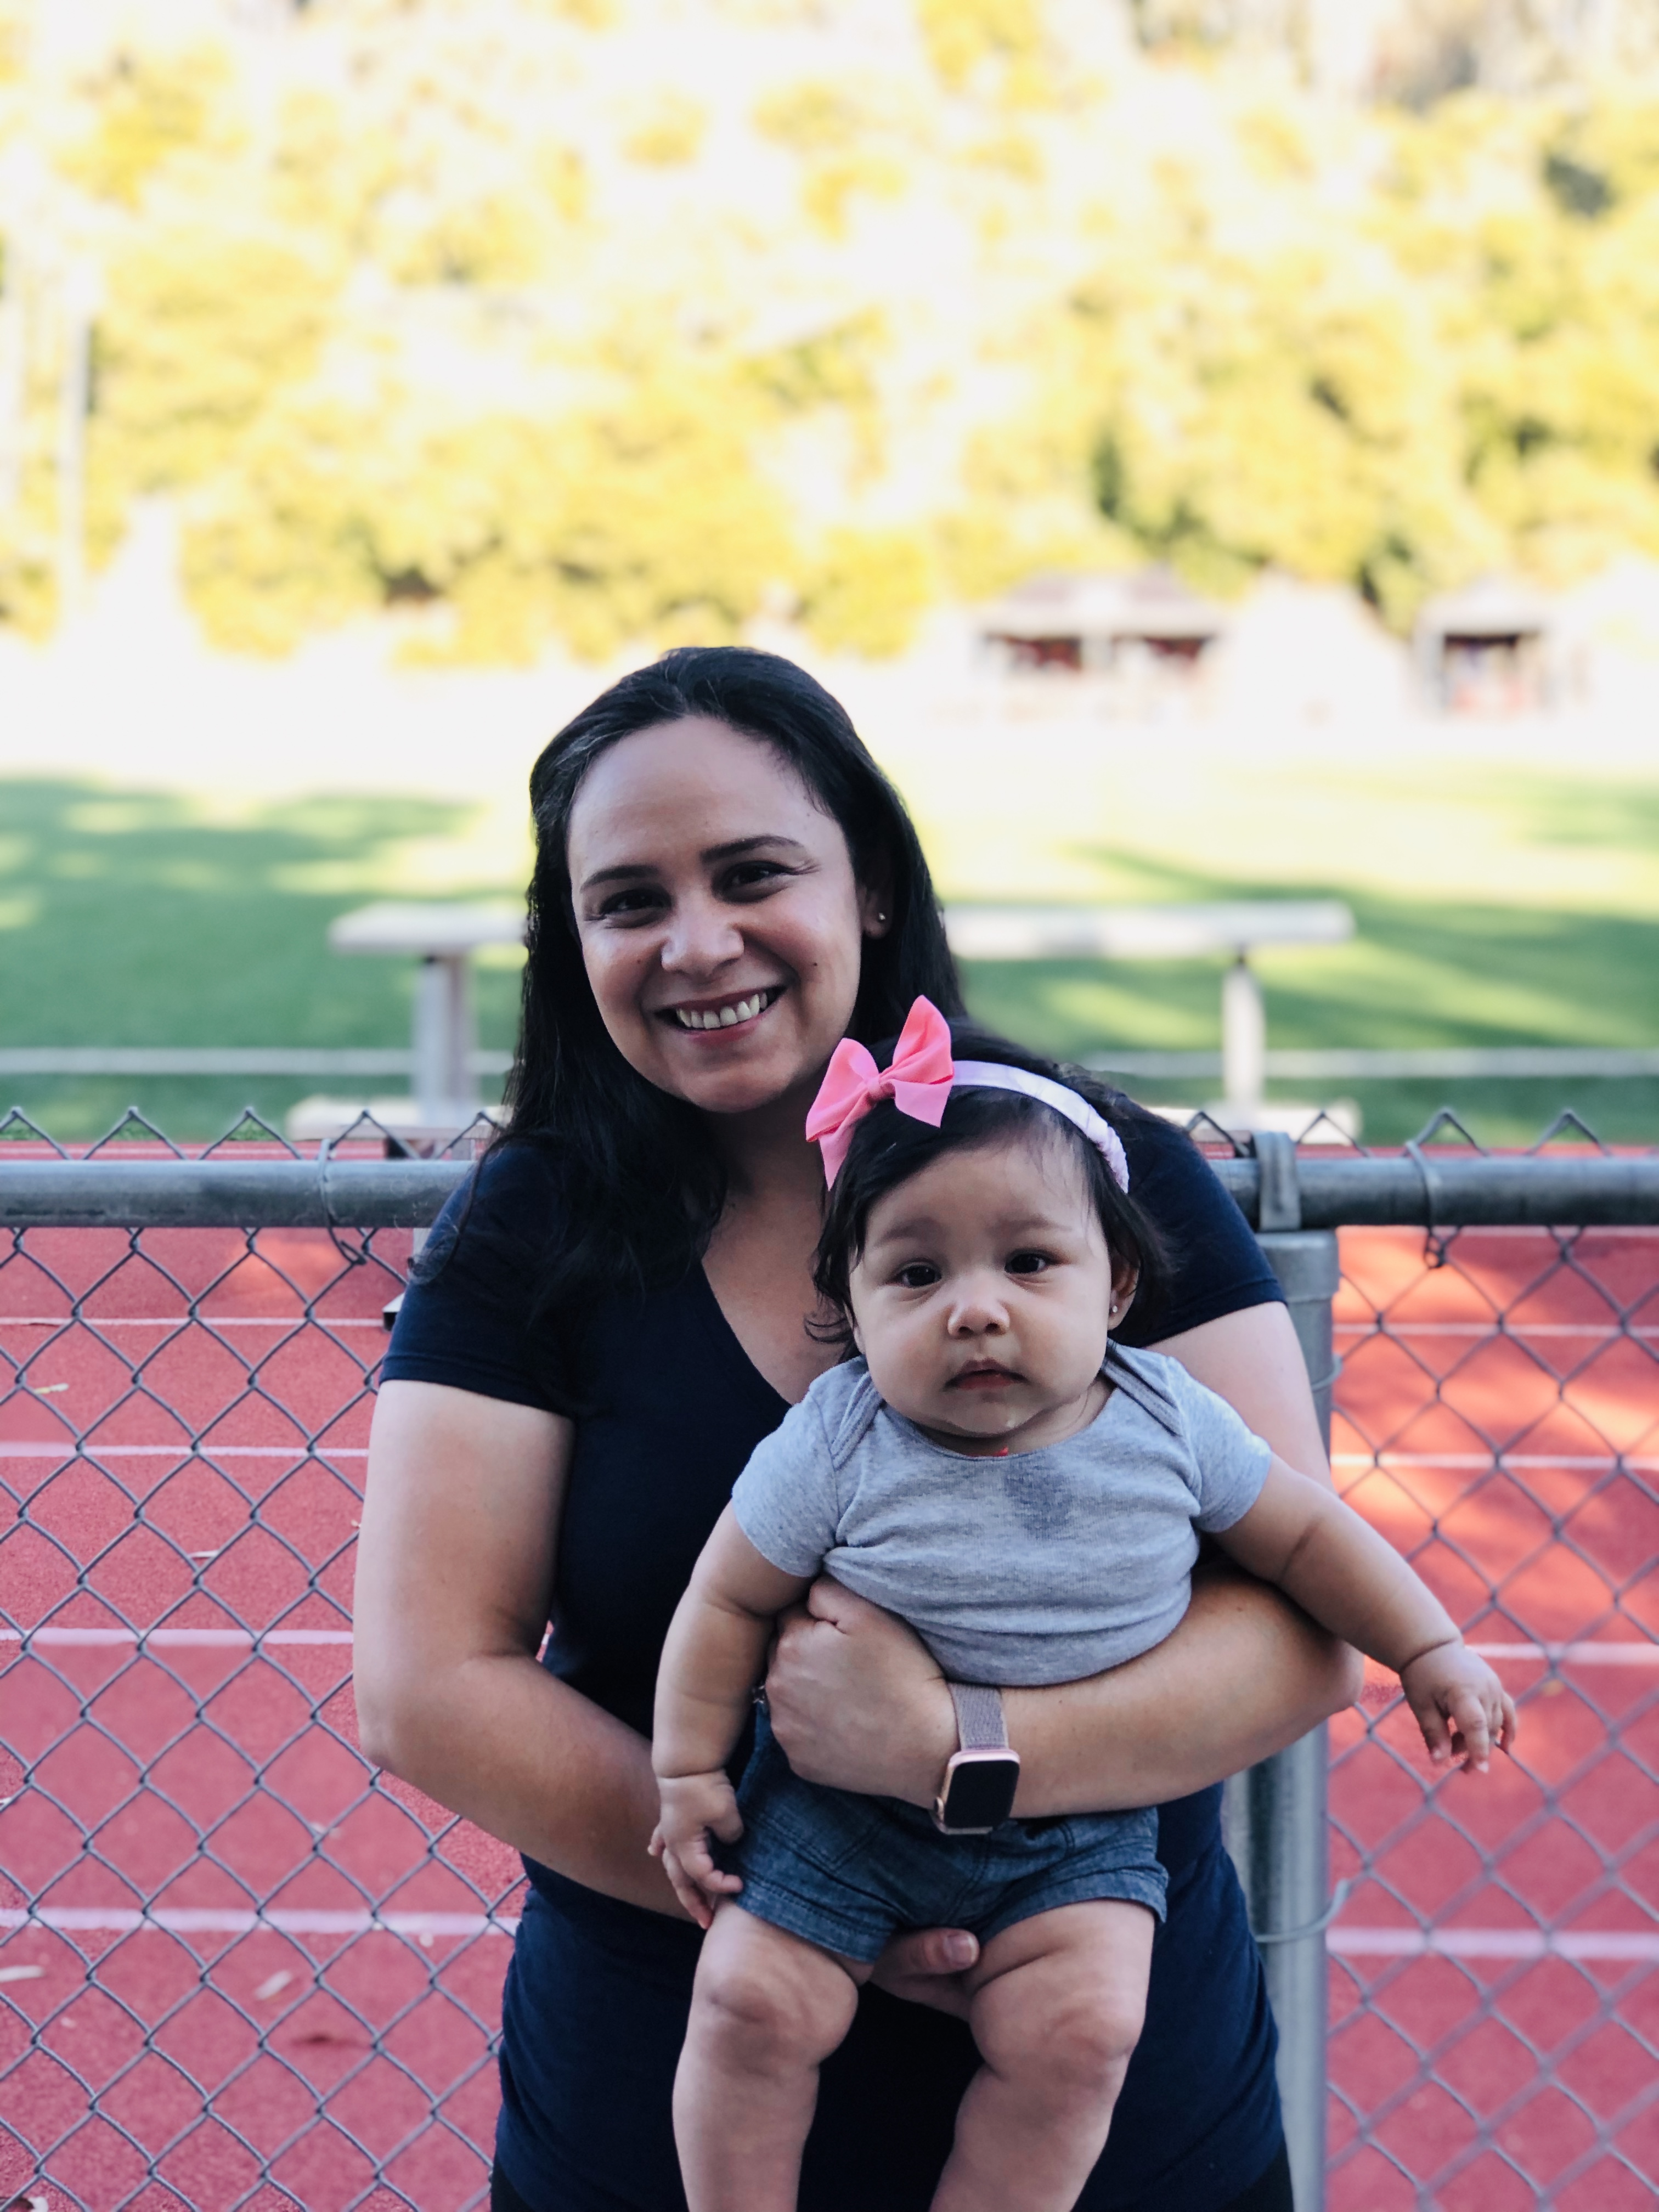
About Me
6th year teaching at St. Luke Catholic School
6th-8th grade math, 7th grade Religion
Working part time this year to spend time with my 6 month old daughter, Belen
Play guitar and lead music for Friday Masses
Decathlon coach (Math)
I love: coffee, milk tea with boba, singing, playing guitar, listening to interesting podcasts, and spending time with my family

Slide 3
7th Grade Homeroom Information and Dates
Class prayer service and potluck
Wednesday September 11th 6:30pm
Class leads prayer service with parents and teachers in attendance, potluck dinner follows
Each family is required to bring one dish (side, main, dessert) more info to come
7th Grade Bake Sale
Thursday October 24th 10:00am
Each family donates/bakes goodies (receive VIP hrs)
Need 2 volunteers to sell during recess
Halloween
Thursday October 31st
Halloween Parade in Parish Hall 8am
7th grade parents set up, serve, clean up lunch and sponsors the snack booth (receive VIP hrs)
Walkathon Lunch
Friday November 22nd 12pm
7th grade parents set up, serve, clean up lunch (receive VIP hrs)

Slide 4
7th Grade Homeroom Information and Dates continued…
7th Grade School Family Mass
Sunday April 5th 10:30am
Students sponsor liturgy by reading, bringing up gifts, greeting parishioners
Student work displayed, parents in charge of hospitality (donuts)
Fiesta
Friday April 24th-Sunday April 26th
All parents required to do minimum 6 fiesta hrs.
Great opportunity to support and share in the parish community, we hope everyone makes an effort to be there all weekend!
7th/8th Grade Dance
Friday ?
7th grade parents set up, clean up
8th Grade Graduation Brunch
Friday June 5th after Mass
All parents needed this day to set up, cook, clean up

Slide 5
Things to know…
Lions’ Lunch is due by Wednesday of every week
Students have PE every ____ and should come to school in their PE clothes
Dismissal is at carline every day at 2pm on Mondays and 3pm the rest of the week. On minimum days, dismissal is at 12:30pm. We ask that you do not leave before the dismissal bell unless you check your child out at the office. If they are going home with someone different, please send a written note and/or email the office.
Please read the weekly newsletter from the school and from myself. They contain important information!
No fast food for lunches or birthdays

Slide 6
School Supplies and Uniform
Please refer to school supply list for materials needed for the first day of school
Make sure your child labels their belongings (pencil bag, binders, backpacks, sweatshirts
Students should be in correct uniform and shoes unless otherwise noted or a free dress day
Shirts tucked in
Belts for boys
Shoes should be mostly all black or all white, NO CANVAS
Socks should be black, white, blue, or gray
Only clear nail polish for girls

Slide 7
Emergency Kits
Emergency Kits need to be turned in by tomorrow if possible. The following
2 water bottles (labeled)
Non-perishable snacks
Cards or small game
Encouraging letter from family and/or pictures
Solar blanket
Make sure emergency contact information is updated in the office. In the case of a real emergency, students will not be released to anyone other than the people on their emergency contact form

